Slide 1


Stakeholder Meeting #2
Asset Mapping
February 2021
www.healthycapitalcounties.org
www.facebook.com/healthycapitalcounties

Slide 2

Today’s Agenda
Welcome
Review Selected Indicators
Asset Mapping Overview
Partnership with Tri-County Regional Planning Commission
Community Survey Overview
Upcoming Meetings
Website update

Slide 3
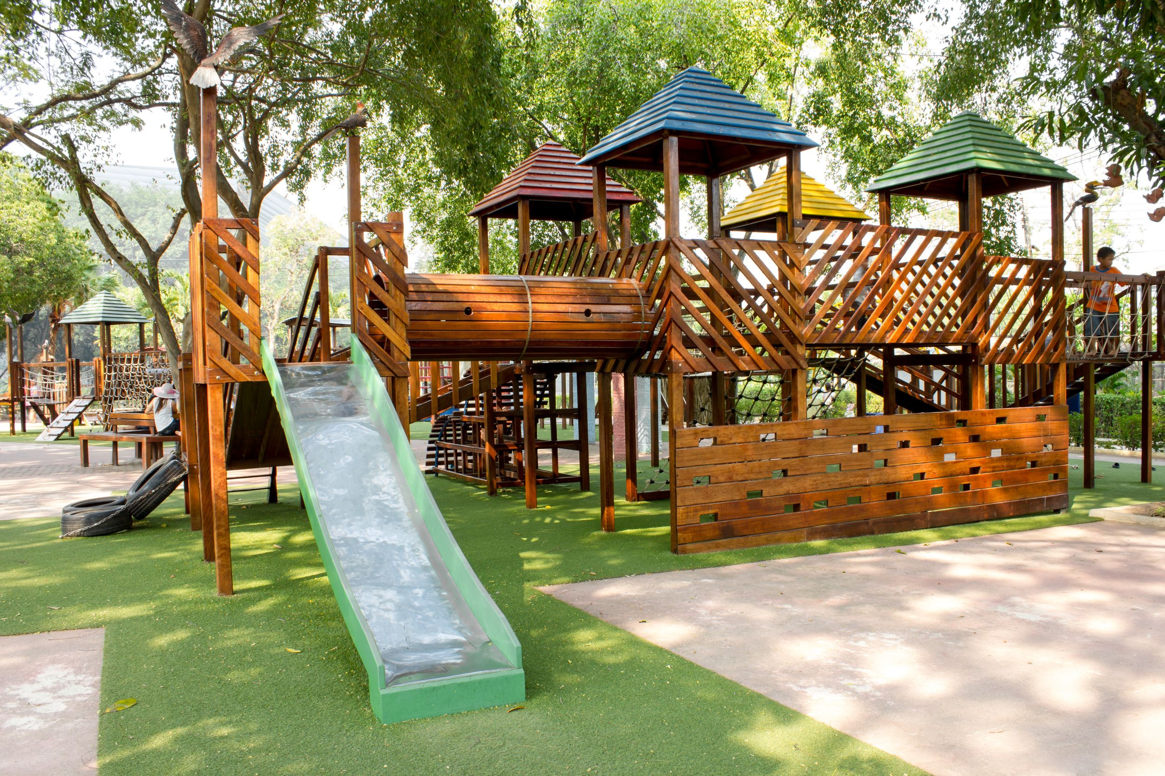
Selected Indicators - 2020
Madhur Chandra, MPA, PhD
Senior Community Epidemiologist
Ingham County Health Department

Slide 5

Poll #1
Do you approve of the indicators presented?

Slide 6

Using Asset Mapping to Improve Community Health in Mid-Michigan
Janine Sinno Janoudi, Ph.D
Ingham County Health Department

Slide 7
What Asset Mapping?
It is a way to assess and mobilize what a community has
Inventory of services, skills, resources in a community at a point in time in a visual way.
Geographic Maps are important visual aids that help highlight available resource distribution in a community.
It is an approach to community planning
  “A means, a PROCESS not an END.”
It allows regions to mobilize their community strengths to build support around issues

Slide 8
Community Asset Categories
    Anything that sustains and improves the quality of neighborhood and community life, including:
    Basic Living Assets:
        Water, air, food availability and access, housing, energy
    Demographics Assets:
        The picture of your region’s diversity
      Public Programs and Services Assets:
        Community based programs, health and social services
Notes:
Demographics: Racial and ethnic diversity can be indicative of economic and behavioral patterns. For example, racially, ethnically and ability homogeneous areas are sometimes representative of concentrated poverty or concentrated wealth. They could also be indicative of discriminatory housing policies or other related barriers. Or if an area has a high concentration of aging population, do they have when they need to age in place?

Slide 9
Community Asset Categories
    Infrastructure/Physical/Environmental Assets:
        Community buildings, trails, parks, streets, safety measures
    Private Sector Assets:
        People who provide services in the community
    Skills Development Assets:
        Economic/labor/education opportunities
Notes:
Demographics: Racial and ethnic diversity can be indicative of economic and behavioral patterns. For example, racially and ethnically homogeneous areas are sometimes representative of concentrated poverty or concentrated wealth. They could also be indicative of discriminatory housing policies or other related barriers.

Slide 10
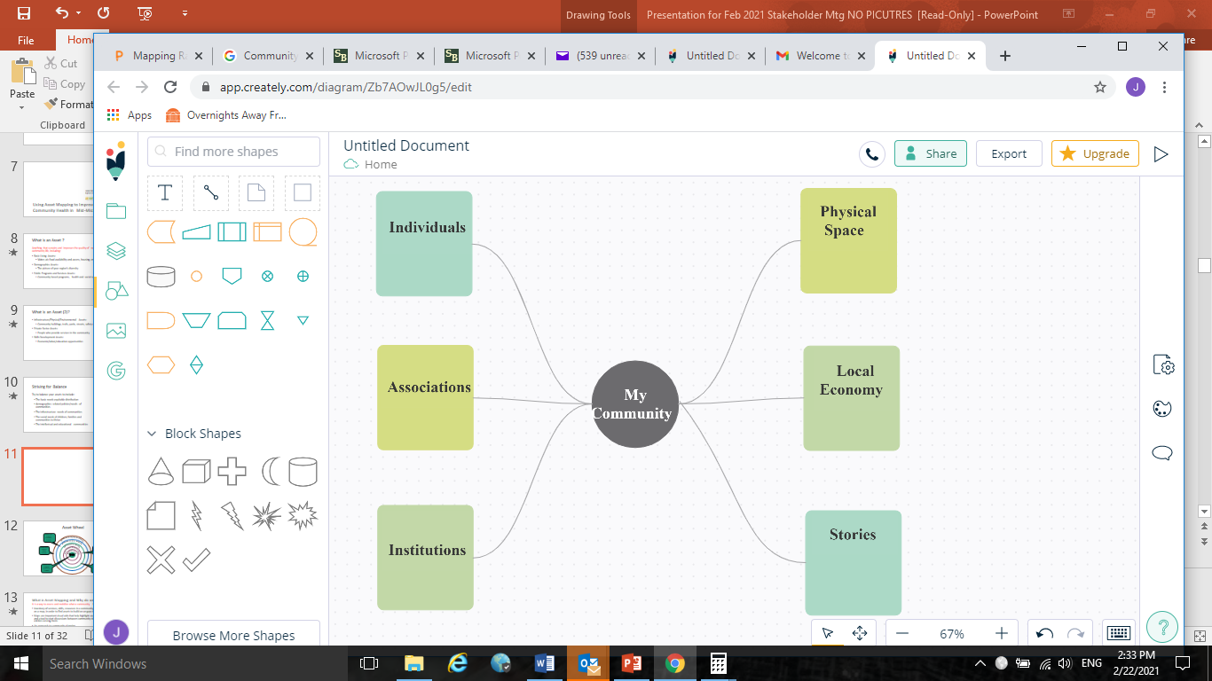
What is Assets Mapping/Visualization

Slide 11
Key Benefits of Asset Mapping
    Helps build partnerships in communities
    Avoids duplication of services
    Is a model that treats professionals and community members as assets
    Strives for balance in communities rather than ‘fixing’ communities
    Stimulates solution-focused thinking
    Builds long-term assets in the community

Slide 12
Why is Asset Mapping Useful for Sustainability and Community Health Assessments?
Asset mapping brings the strengths of the community, along with the strength of partners and experts, together to develop a ‘whole region’-balanced solution
It protects from depletion of resources
For community health assessments and improvement planning, it is important to consider assets before and after deciding on health priorities

Slide 13

Steps in Our Asset Mapping Process
Step 1: Introduce the asset mapping concept and how it relates to social determinants of health
Step 2: Identify asset categories for mapping
Step 3: Identify existing/readily available data for assets
Step 4: Identify categories that need more GIS data
Step 5: Prioritize the assets to focus on in next few months
Step 6: Asset Mapping Team collects the data sets in GIS
Step 7: Develop an asset geo map
Step 8: Stakeholders validate the asset mapping output

Slide 14
Steps so far…
    Prior to today, we’ve tried to identify some of the asset categories needed as determinants of health
    We reached out to regional planning partners and looked online to identify what asset data sets are readily available
    We’ve assessed our capacity to produce asset maps/tools for the project
      Utilize Tri-County Regional Planning Commission’s experience and expertise

Slide 15
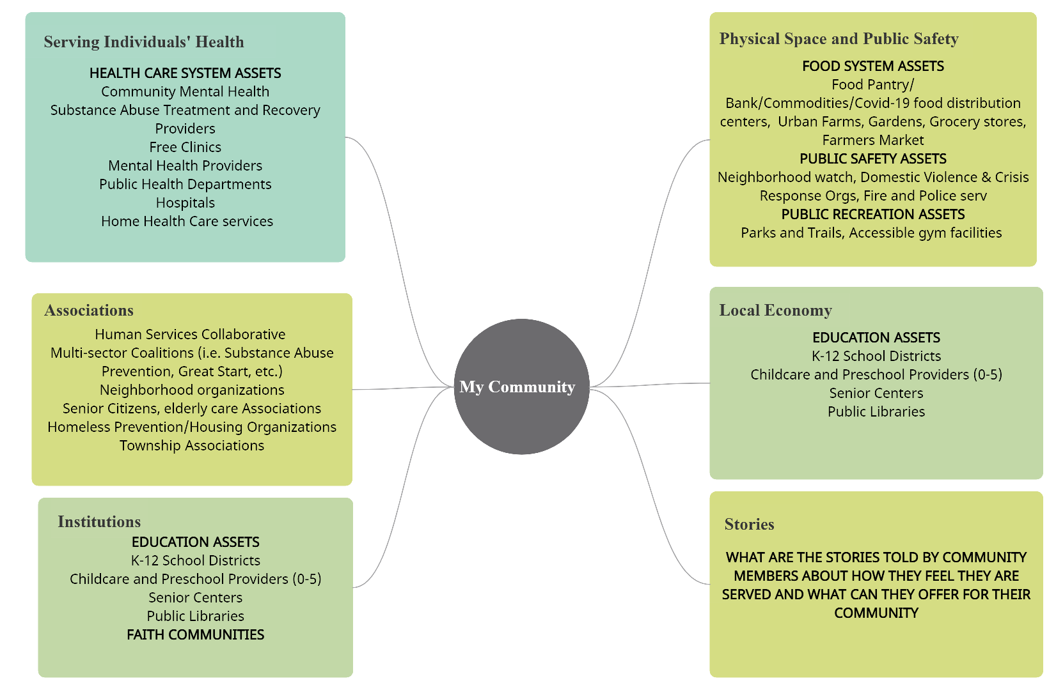
ASSETS CATEGORIES –VISUALISATION

Slide 16
Assets Mapped in the 2018 cycle of H!CC
In the last Cycle the community meeting then generated 3 top priorities of assets to plot on a geo map for the region:
Food Access
Community Mental Health and Substance Use facilities
Health Care Facilities

Slide 17
How did the community benefit?
Example: Food Access:
Following the initiation of the mapping process discussion in the last cycle, the Capital Area Food Council has developed now a map available to community members on their website a participatory map where anyone in the food system can add in their location as an asset:
https://www.capitalareafoodcouncil.org/food-map.html

Slide 18
HOW YOU CAN HELP IN 2021
If you would like to be part of this Asset Mapping Development Team, please send an email to:
Rex Hoyt: Rhoyt@mmdhd.org
Janine Sinno Janoudi jsinno@ingham.org
Or Ken Hall: khall@mitcrpc.org

Slide 19
Poll #2
ASSET INVENTORY - Healthy! Capital Counties
HEALTH CARE SYSTEM ASSETS
Community Mental Health
Substance Abuse Treatment and Recovery Providers
Free Clinics
Hospitals
EDUCATION ASSETS
K-12 School Districts
HOUSING ASSETS
Homeless Prevention and Housing Organizations
FOOD SYSTEM ASSETS
Food Pantry/Bank/Commodities
PUBLIC SAFETY ASSETS
Domestic Violence & Crisis Response Orgs
EMPLOYMENT ASSETS
Unemployment and Job-placement Services
ORGANIZATIONAL ASSETS
Human Services Collaboratives
Of the assets listed, which would you most like to see mapped for our communities in the 2020 cycle?

Slide 20

Partnership with Tri-County Regional Planning Commission
Ken Hall
Tri-County Regional Planning Commission

Slide 21

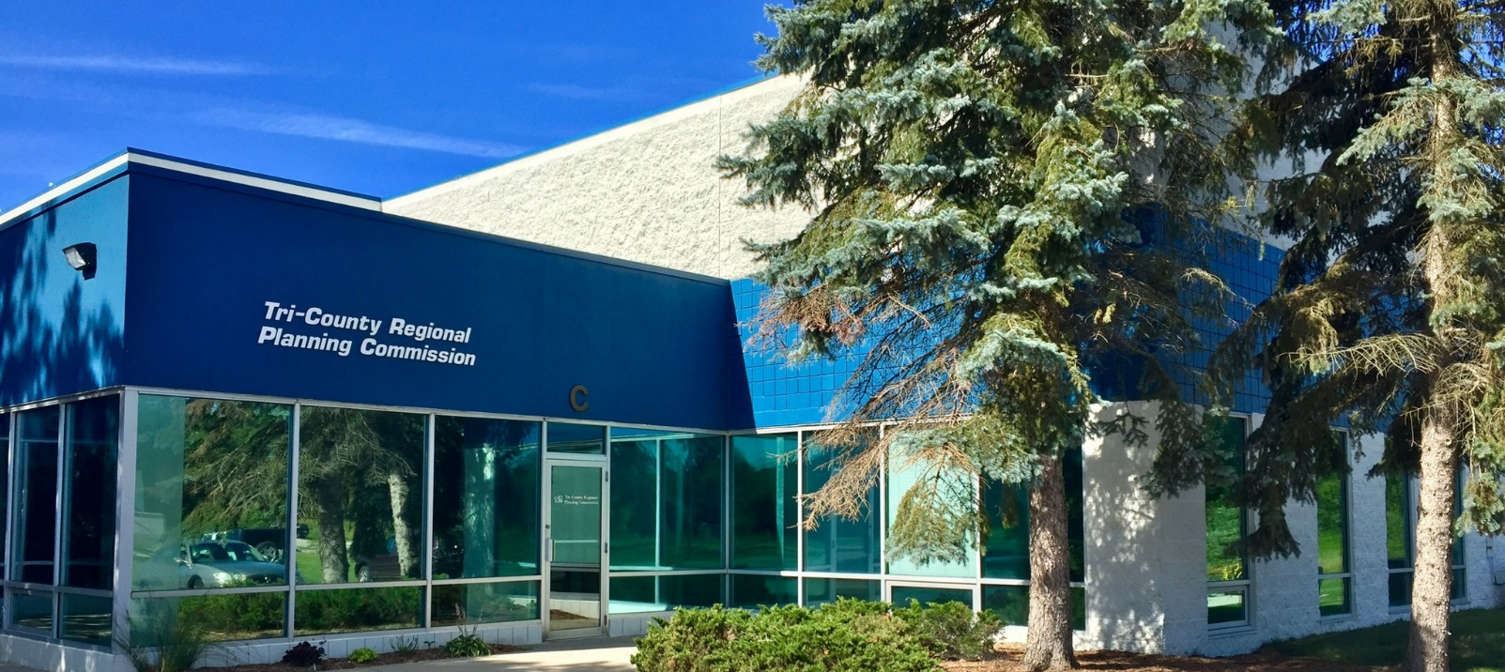
Who Are We?
Serves Clinton, Eaton, and Ingham counties (tri-county region)
Governed by 19 commissioners representing the 3 counties + City of Lansing
Plans for transportation, economic development, the environment, and sustainable land use with a regional approach
  Provides technical assistance to local governments
  Develops plans and policies
  Collects and maintains geographic data
  Addresses challenges in Greater Lansing area communities

Slide 22

Tri-County Planning is also…
Designated as the region’s Metropolitan Planning Organization (MPO) to coordinate federally-funded transportation projects
Designated by the U.S. Department of Commerce as the Economic Development District (EDD) to facilitate federally-funded economic development programs and initiatives

Slide 23


Geographic Information Systems (GIS) & Online Interactive Mapping
Software designed to capture, manage, analyze and display all forms of geographically referenced information
ArcGIS Online software creates maps, data and analytics that can be published into an online interactive map with its own web address
Collaborate and share content privately or open to the public via mobile devices and desktop viewers
Many customizable features or widgets can be added such as:
        Drawing tools & infographics
        Edit features
        Add data

Slide 24
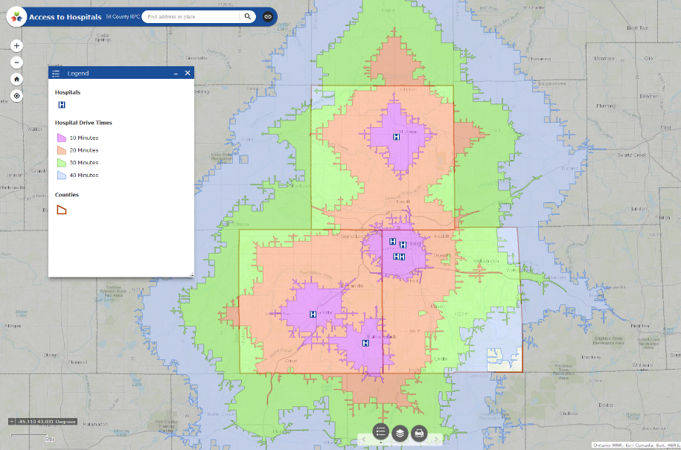
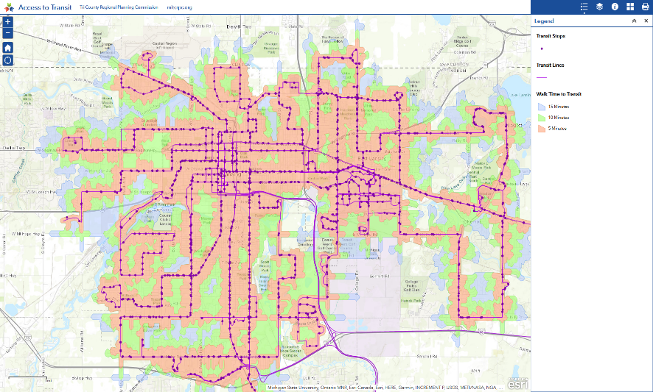
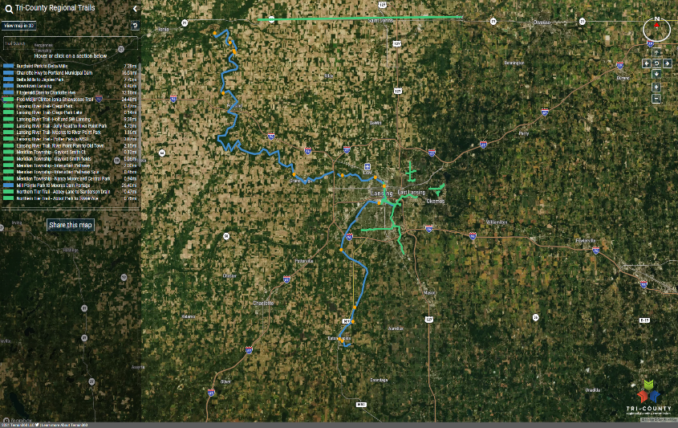
Tri-County Regional Online Mapping Examples
Access to Hospitals
Access to Transit
Tri-County Regional Trails
24
Notes:
https://tcrpcgis.maps.arcgis.com/apps/webappviewer/index.html?id=fddf3557c5d84bd8bab643a92fa38836
https://tcrpcgis.maps.arcgis.com/apps/webappviewer/index.html?id=d22225a985aa40eebc6588a323521a3b
https://tcrpcgis.maps.arcgis.com/apps/webappviewer/index.html?id=2d0714fb741748d6aaadcc68251064ce
https://tcrpcgis.maps.arcgis.com/apps/CrowdsourceReporter/index.html?appid=d5151985a6f342ffb6bdcc7dc22638f4

Slide 25
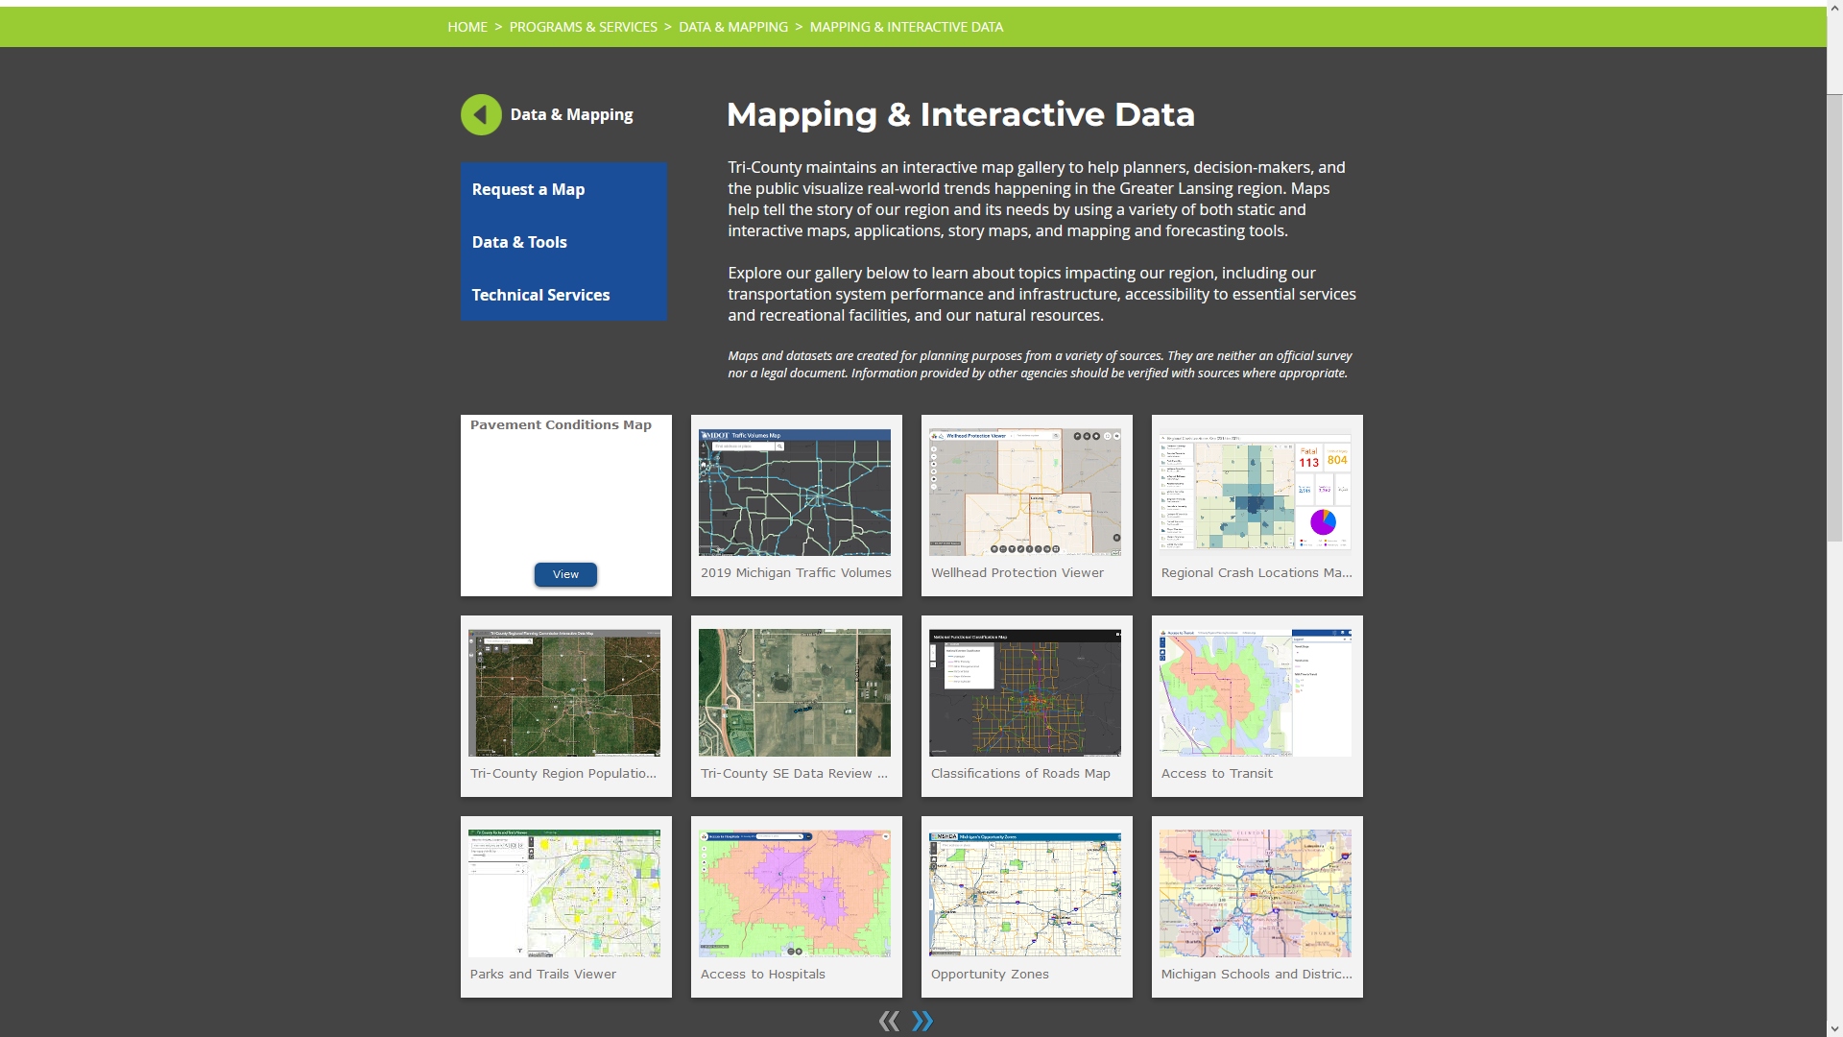
Tri-County Regional Mapping & Interactive Data
Tri-County is always looking to learn more about the data and visualization needs of our community.
Don't see a map you're looking for? Request one using our request form at mitcrpc.org/maps.
We can research what data is available and determine the feasibility of producing a map or web application!
TCRPC Mapping & Interactive Data

Slide 26

Community Survey
Madhur Chandra, MPA, PhD
Senior Community Epidemiologist
Ingham County Health Department

Slide 27
Purpose of Community Survey
Provides an opportunity for anyone from the community to give input on health.
Incorporates input from those who live in the Tri-county region as well as those who work Ingham-Eaton-Clinton.
Designed to be brief, broad, and easy to complete (5-10 minutes)
Last H!CC cycle over 400 individuals participated.
Several questions on the corresponding health care provider survey are the same, so populations can be compared.
Includes COVID-specific questions this cycle.

Slide 28
New this year…
Additional demographic information such as age, race, ethnicity, urbanicity etc.
Health related concerns associated with the COVID-19 pandemic.
Cultural/language issues as barriers to accessing quality healthcare.

Slide 29
Next Stakeholder Meetings
July 2021
  Virtual Data Party / Review (tentatively)
October 2021
  Summary of complete Community Health Needs Assessment
  Prioritization of health issues

Slide 30
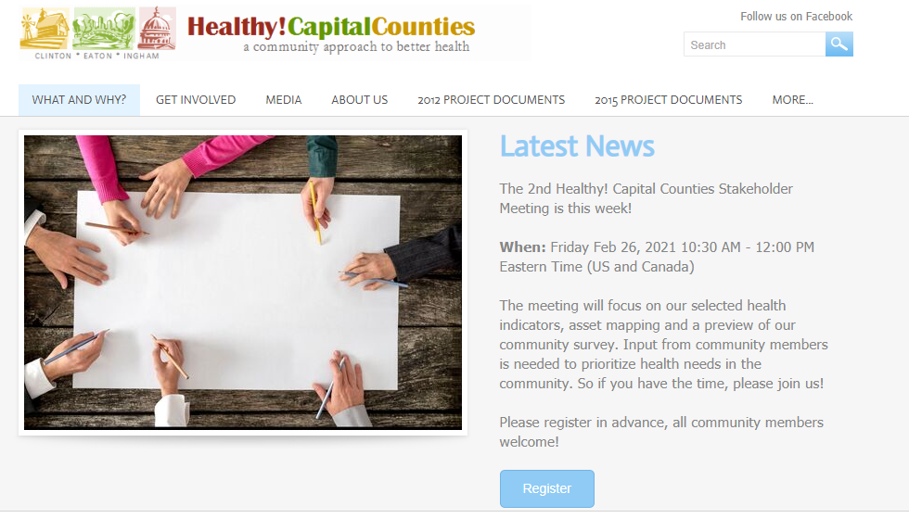
Healthy! Capital Counties Website Update

Slide 31
Thank you for joining!

