Slide 1
The Wonderful World of Data
Anne Klein Barna, MA, Health Analyst
Barry-Eaton District Health Department
abarna@bedhd.org

Slide 2
Outline
9:00 am Introductions / Participants
11:30 am Lunch
3:30 pm Reflecting and Debriefing

Slide 3
What’s your data story?
How have you used data in the past?
How do you need to use it now?

Slide 4
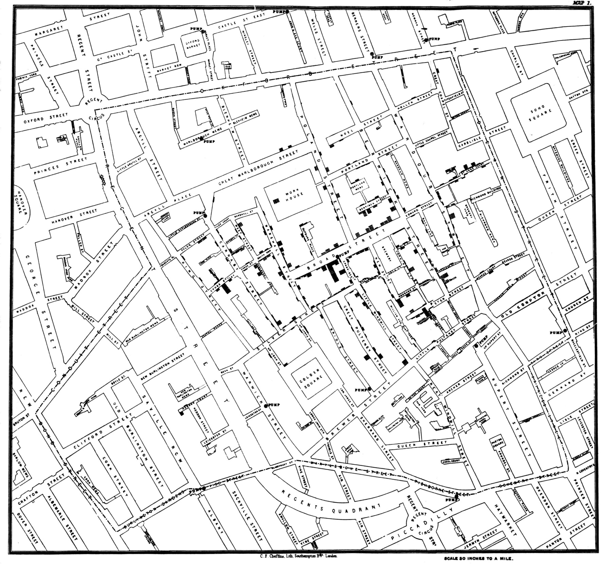

Slide 5
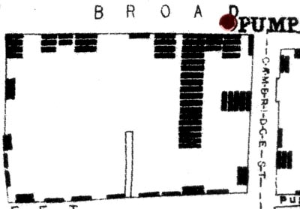
Why data?
To help us solve our problems.

Slide 6
Disclaimer
My experience is in working mostly with health and substance abuse prevention data. The information presented will reflect this reality.
I welcome participation to identify additional data issues relevant to other problems and groups!
Speak up!

Slide 7
What is data?
Notes:
Introduction; icebreaker

Slide 8
How do we measure things?
WHAT do we measure?
Objects
Behaviors
Events
Thoughts
Beliefs
Rules
Direct observation
Indirect observation
Sampling/Testing
Scales and Indexes

Slide 9
Who are we?
Community
  Culture --- shared set of beliefs and behaviors due to common history
  Society --- group bound by social networks, geography
  Population --- people that live in a defined area
  Are the cultures of different regions of Michigan different?
  What are some ‘societal’ differences between the realities of urban environments vs. rural ones?
  How do demographics and culture affect how we interpret our data?

Slide 10
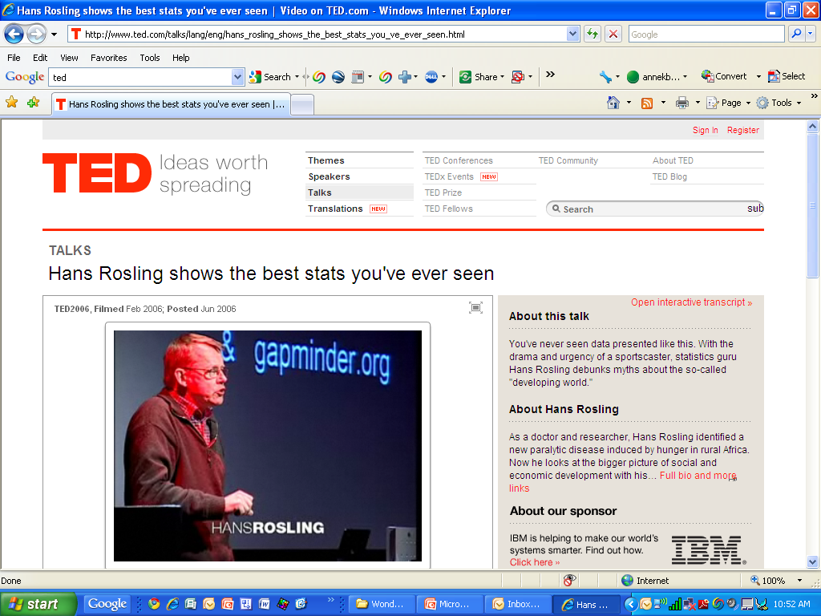
The Best Stats You’ve Ever Seen
http://youtu.be/RUwS1uAdUcI

Slide 11

Circle Chart Hall of Fame
When I began to see more and more process charts in public health, substance abuse prevention, they all started to look strangely familiar…

Slide 12
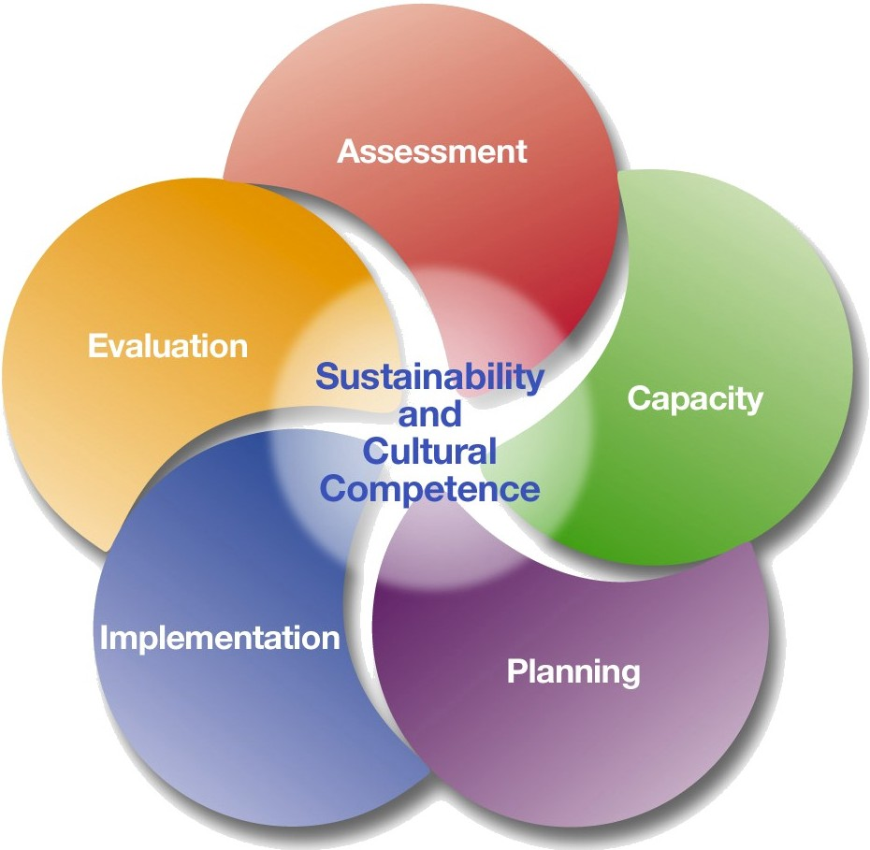
Strategic Prevention Framework

Slide 13
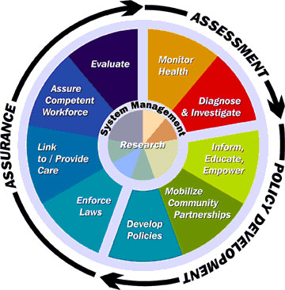
Ten Essential Public Health Services
http://www.ecu.edu/cs-dhs/dph/images/publichealthwheel_1.jpg

Slide 14
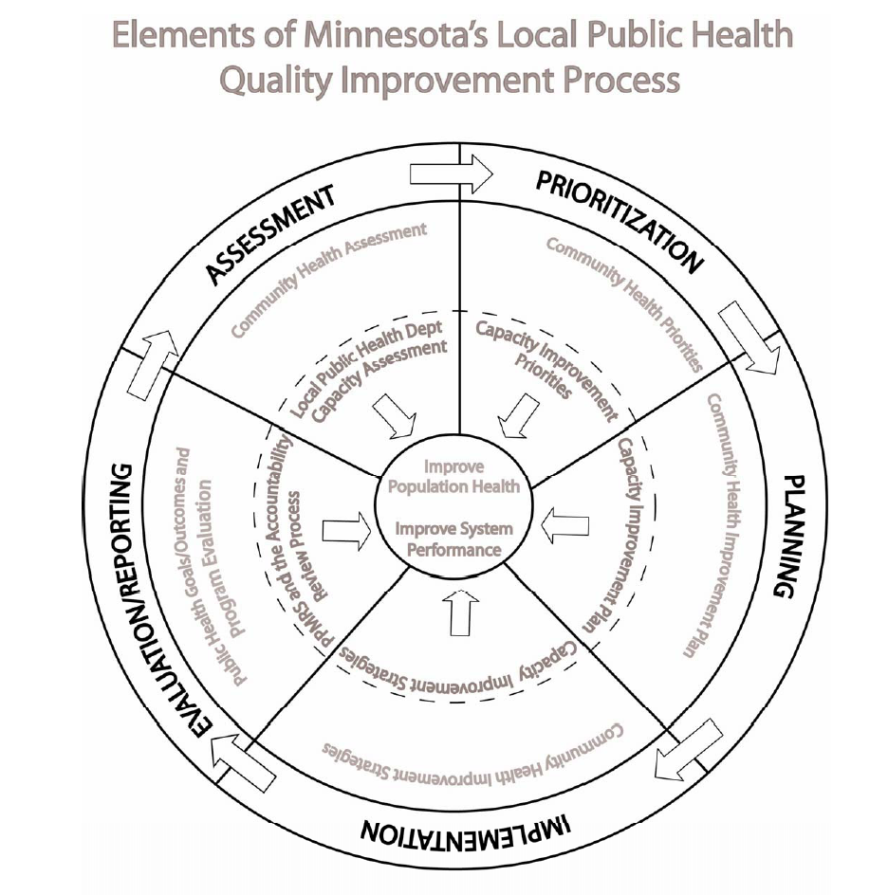

Slide 15
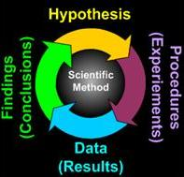
The Scientific Method
http://www.humansfuture.org/methodology_scientific_method.php.htm

Slide 16
Selecting data to describe your problem

Slide 17
How do we usually measure social or health problems?

Slide 18
Geographic Units
Country
  State
    Region (District Health Department, Court, Substance Abuse Coordinating Agency, etc.)
      County
        School District
        Municipality (cities, villages, townships)
          Census tracts
            Block groups
              Households
                Individuals

Slide 19
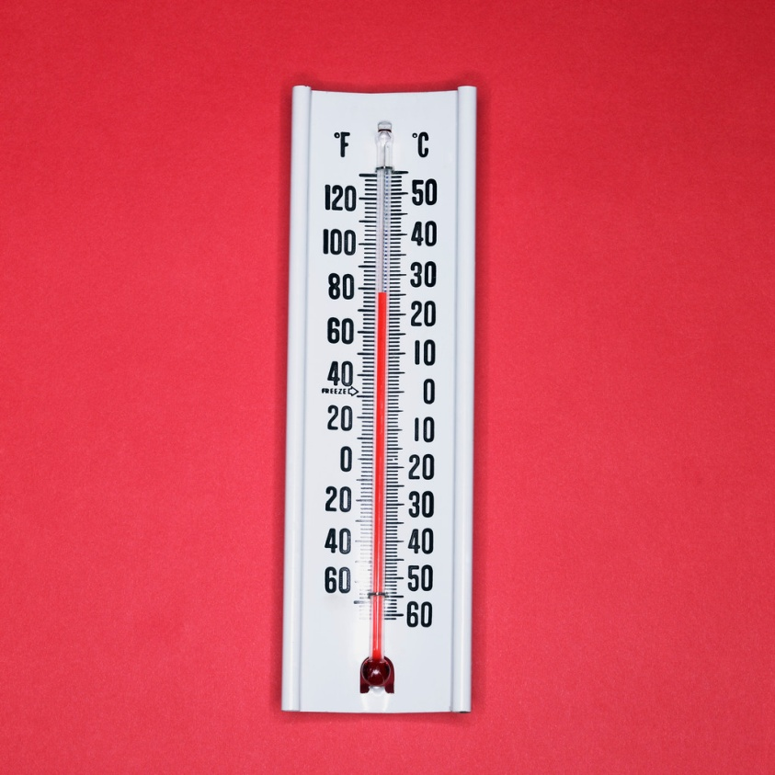
Validity and Reliability
Reliability: same result, again and again
Validity: measures what it claims to measure

Slide 20
Unit of Analysis
33% of schools have a healthy lunch policy
33% of families are homeless
33% of children are immunized

Slide 21
Data Jargon
What is a rate?
Is percent a rate?
What is a point estimate/frequency?
a single point of data (i.e. 54%, or 3 per 1000)
Incidence – discrete in time
(# new cases of cancer this year)
Prevalence – measure of the population burden (% of women with diabetes)
Others?

Slide 22
Group Work: Data Basics: Overview
This morning:
Work together to complete the worksheet on your table. A copy for your reference is provided in your packet, so please write on the big one!
This afternoon:
Using the data and concepts you collected on the worksheet, each group will construct a two-page data report that communicates the problem so that strategic planning will be effective.

Slide 23
Table Activity PART ONE
The goal of this activity is to teach how to think broadly about data that’s relevant to understanding a social problem, as well as what sorts of data might be used. It’s also a rudimentary logic model!
Each group has a “big” multi-colored worksheet.
Given the interests of the group members, choose a “problem” that will serve as your example.
Write that in the top box as the ‘problem’.

Slide 24
Finding Meaning in your Data
In Community A, the percent of people with adequate physical activity is 50%. Is that good or bad? Getting better or worse? Better or worse than other areas?

Slide 25
How do we know if our data mean anything?
Comparisons
  Geographical
  Rankings
Trends
Cross-trending
  Comparing trends
Significance!
Confounding variables
  This means that there are additional pieces of information that we need to account for.
  Ex: DUI arrests

Slide 26
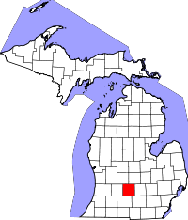
Comparisons
surrounding counties
similar counties
State
Country
Ranked order
See www.countyhealthrankings.org
Eaton County

Slide 27
Trends
Allow us to see what is happening over time

Slide 28
Cross trending

Slide 29
Significance
If two rates are statistically significant, that means that we are very confident that the difference between them did NOT arise by chance.
What is a point estimate?
20.3 % Current Smoking Rate in Michigan 2007-2009 Behavioral Risk Factor Survey
What are confidence intervals?
The 95% CI is (19.6-21.0)

Slide 30
Is it significant?
Health Department District | Sample Size | Point Estimate | 95% Confidence Interval
Barry-Eaton | 458 | 25.6 | (20.6-31.3)
Clinton, Gratiot, Montcalm | 594 | 20.5 | (16.7-25.0)
Ingham | 653 | 15.5 | (11.4-20.8)
STATE | 26,086 | 20.3 | (19.6-21.0)

Slide 31
Are they significantly different?

Slide 32
Community-level Variation
Consider this…
Community A is implementing an (ineffective) tobacco cessation intervention, compared with Community B, which is not. The program is evaluated by comparing quit rates between communities (controlling for sociodemographics and health characteristics).
What is the chance of finding a difference in quit rates between communities?

Slide 33
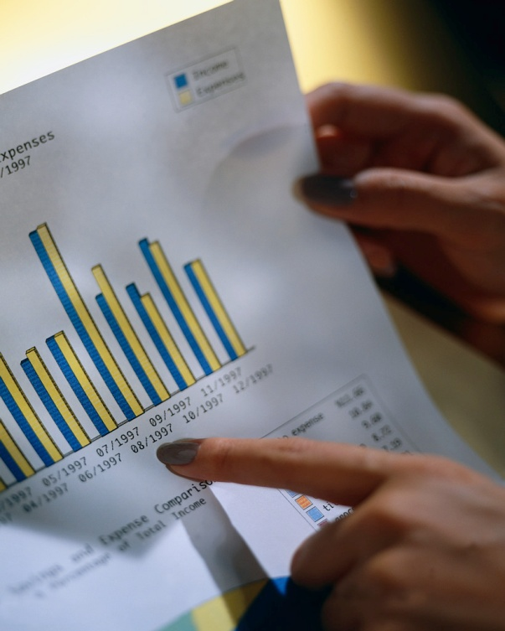
Data Sources
Where do I find it?

Slide 34


Demographics
The word demographic comes from the Greek word demos for people and the Greek word graphie for writing.
100% of these people are excited about data!

Slide 35
The Census
www.census.gov
Your source for denominators!
New American FactFinder
http://factfinder2.census.gov/faces/nav/jsf/pages/index.xhtml
What about Census 2010 data?
The census website is faster in the morning. Why?

Slide 36



www.census.gov
Census
American Community Survey
  1 year estimates (65,000+)
  3 year (20,000+)
  5 year (under 20,000)
  http://www.census.gov/acs/www/Downloads/handbooks/ACSRuralAreaHandbook.pdf
Current Population Survey

Slide 37
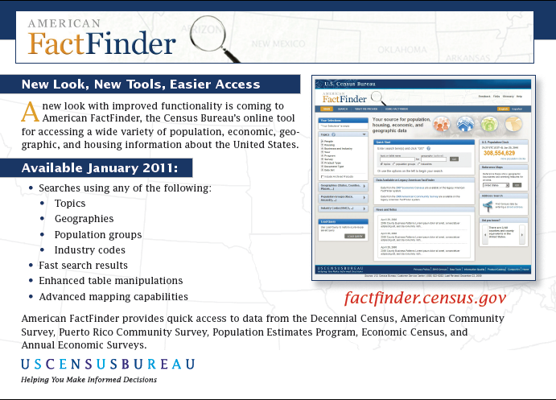

Slide 38
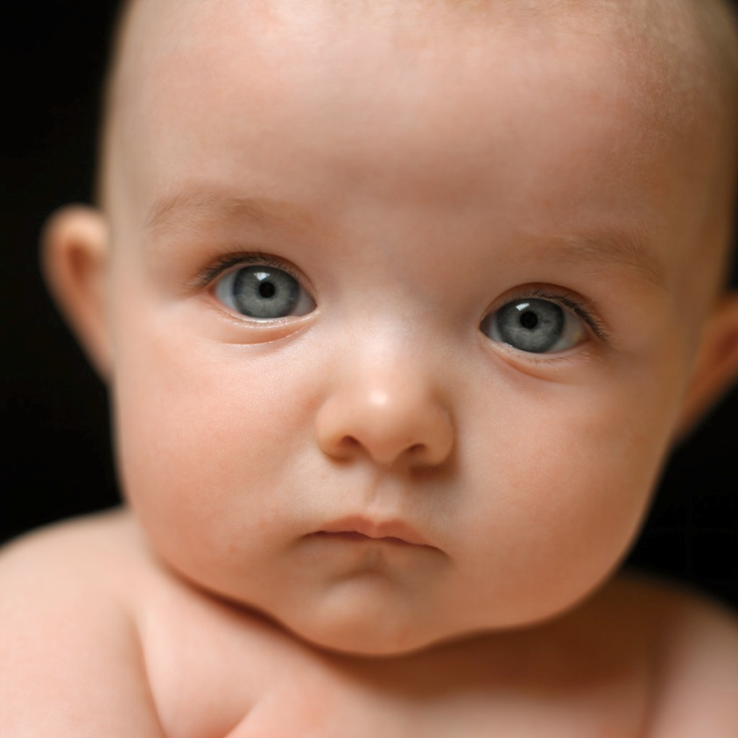
Health Data
Vital Statistics
  “Natality”
  means data on babies!
  We keep really good records of births.
  Common items:
  infant mortality
  Teen pregnancy
  Adequate prenatal care
  Maternal characteristics

Slide 39
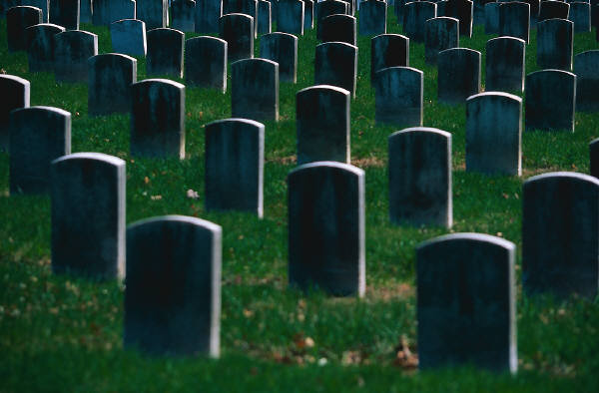
Health Data
Vital Statistics
  “Mortality”
  means deaths.
  We keep really good records of deaths, too.
  Common items:
  Cause of deaths
  Death rates
  Premature deaths

Slide 40
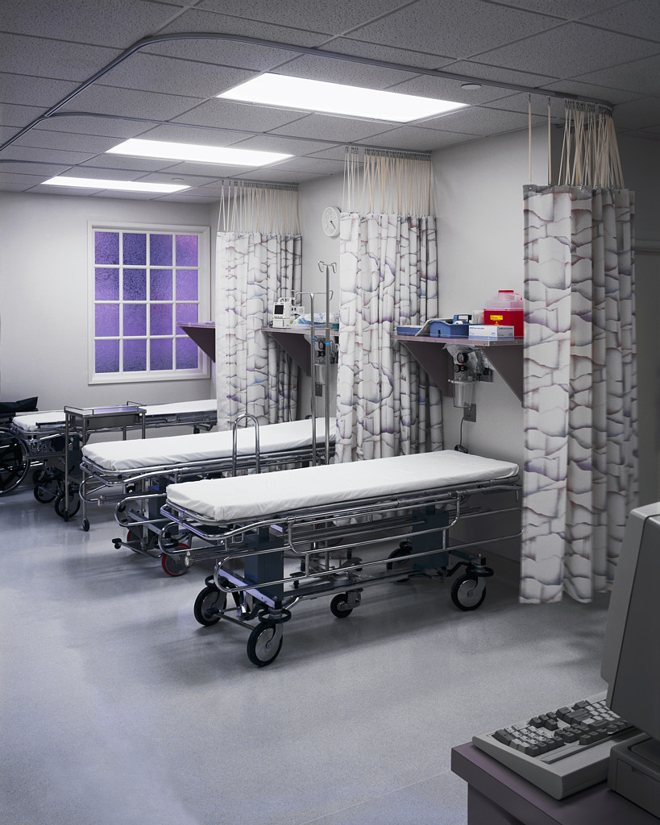
Health Data
Vital Statistics
  “Morbidity”
  means sickness.
  This data is better for some conditions than others.
  Common items:
  Incidence of disease
  Prevalence of disease (usually measured thru surveys)
  Hospitalizations

Slide 41
Michigan Department of Community Health Vital Stats Website
http://www.mdch.state.mi.us/pha/osr/chi/IndexVer2.asp
This is the handicapped accessible site, it’s also the best, I think.
www.michigan.gov, enter “vital statistics” into the search bar, click on the top link.
Timeliness
Data requests
(Utilize your local public health department to submit your requests if time is a concern. MDCH has an order of priority response, and LPH is at the top. ☺ )

Slide 42
Health Surveys
Behavioral Risk Factor Survey [ADULTS]
local, state, national
http://www.michigan.gov/mdch/0,1607,7-132-2945_5104_5279_39424_39427-134707--,00.html
Michigan Profile for Healthy Youth [YOUTH]
district, county
http://www.michigan.gov/mde/0,1607,7-140-28753_38684_29233_44681---,00.html

Slide 43
Types of Data
Survey Data
  Directly measure a characteristic of a population
  Use sampling, results can be generalized
Administrative Data
  Vital Statistics (probably the most representative)
  Court Records
  Educational Records
  Program Records

Slide 44
Health Administrative Data
WIC program
Department of Human Services
MCIR (Michigan Care Improvement Registry)
  Immunizations
Hospitalization Data
Health Plan Data
Community Mental Health

Slide 45
Court / Law / Safety
Administrative Data Sources:
Medical Examiner
Uniform Crime Report
Michigan Traffic Crash Facts
Drunk Driving Audit
Court Data
District Court
Circuit Court

Slide 46
Basic Human Services
Data Sources
Department of Human Services ‘Green Book’
Homeless Management Information System
(HMIS) for Housing Services Providers

Slide 47
Education Data Sources
Center for Educational Performance and Information
http://www.michigan.gov/cepi
Publicly available data on schools and student
(Also more data available thru ISD request)
http://www.schoolmatters.com/
School Matters website has basic info as well, meant for parents
MI Dept of Education has other programmatic data available as well, such as Early On, Special Education Rates, etc… Get w/ your Great Start collaborative.
NEW! www.mischooldata.org

Slide 48
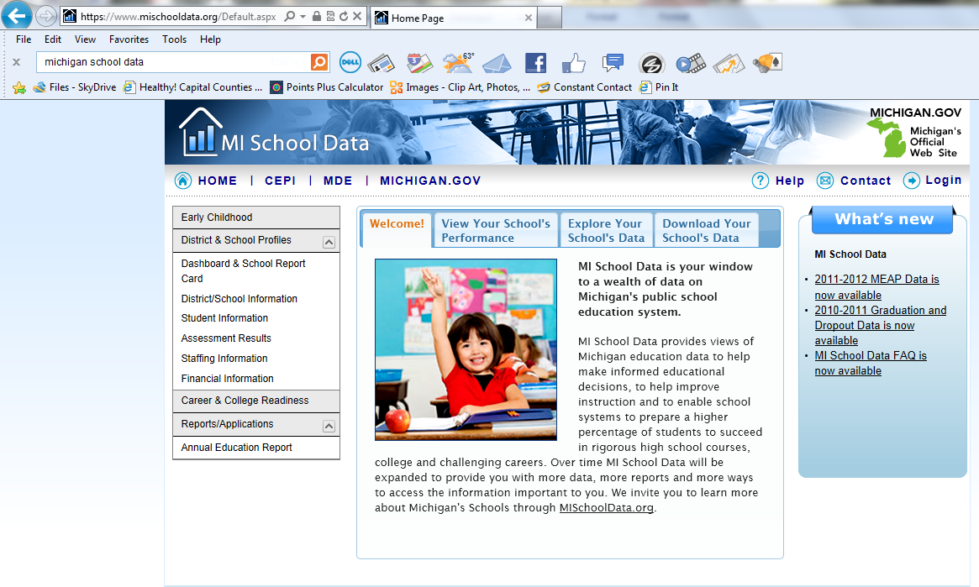
www.mischooldata.org

Slide 49
Data Availability
Publicly available data sets
i.e. MiPHY by County Reports
Public Data that must be requested
i.e. raw MiPHY dataset by County
FOIA requests
Local data – working with data committee members or yet-to-be members ☺

Slide 50
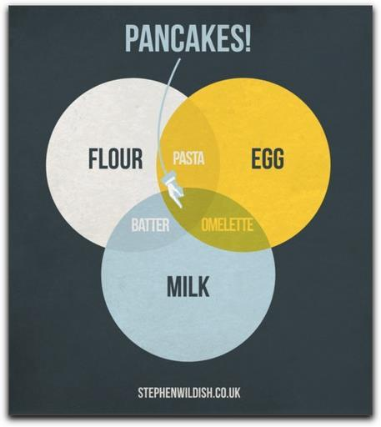
Table Activity PART TWO

Slide 51
a. How do you measure this problem?
Count?
35 suicide deaths
Rate?
  20% of adults are current smokers
Using the laptop and the internet, can you find data to put in this box?

Slide 52
b. So, who cares if they do that?
Why is it a problem?
What are the bad things that the “problem” causes?
  Example: lung cancer deaths, child asthma hospitalizations, heart attacks
  Using the laptop and the internet, can you find data to put in this box?

Slide 53
c. What are the group breakouts?
  What are the rates in different groups?
  income, race/ethnicity, rural/urban, zip code, age groups, etc.
  Using the laptop and the internet, can you find data to put in this box?

Slide 54
Secondary Data Sources of Interest
KIDSCOUNT + Right Start
County Health Rankings
  Also, the overlooked Community Health Status Indicators
Drunk Driving Audit
Community Assessments in your area such as the Power of We, Great Start Collaborative
Food Environments Atlas

Slide 55
Primary vs. Secondary
Vital Stats, BRFS Survey, DHS Green Book are examples of ‘primary sources’. What are advantages of these?
KIDSCOUNT, County Health Rankings, and Power of We Data Report are examples of ‘secondary indicator sets’. These groups take a variety of primary source data and select indicators to measure a particular problem or question. Why use secondary indicator sets?

Slide 56
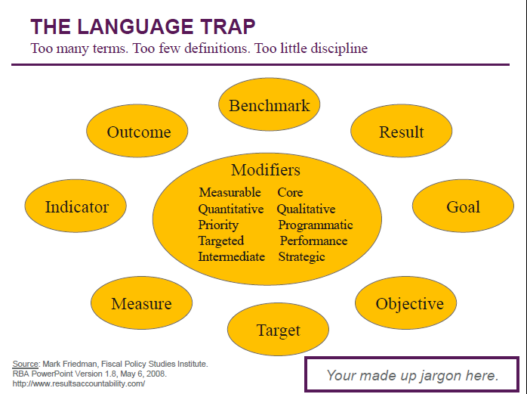

Slide 57
“Outcomes”
In much of our work, we are now asked to find, measure, and target our work on outcomes. How do you tell if your data is measuring an outcome? Does it depend on the question you are asking?
  Example: Teen pregnancy rate
    Teen pregnancy is an outcome of binge drinking
    School readiness is an outcome of teen pregnancy
Another word that can sometimes be substituted for outcome is consequence. What are examples of measuring a behavior vs. a consequence?
  Example: Adult smoking rate vs.
  lung cancer deaths due to smoking

Slide 58
“Determinants”
Just as we are now asked to look at outcomes, we are also asked to look at determinants. What are determinants?
Determinants of teen pregnancy:
  Social class
  Race
  Gender
Determinants of Smoking
  Age
  Income

Slide 59
Chain of Causation
C
A
B
C

Slide 60
Distinguishing Disparity from Inequity
Health Disparity
A disproportionate difference in health between groups of people.
(By itself, disparity does not address the chain of events that produces it.)
Health Inequity
Differences in population health status and mortality rates that are systemic, patterned, unfair, unjust, and actionable, as opposed to random or caused by those who become ill.*
*Margaret Whitehead

Slide 61

This image is from the cover of the first edition.

Slide 62
Where does Prevention Begin?
Where do we Focus?
Social Determinants of Health
The economic and social conditions that influence the health of individuals, communities, and jurisdictions as a whole.
They include, but are not limited to:
Safe
Affordable
Housing
Quality
Education
Job
Security
Social
Connection
& Safety
Living
Wage
Access to
Transporta-
tion
Availability
of Food
Dennis Raphael, Social Determinants of Health; Toronto: Scholars Press, 2004
Notes:
However,
If we reduce disparities at the level of Social Determinants of health,
will we be reducing health inequity?

Slide 63
Root Causes
Institutional
Racism
Gender
Discrimination
and Exploitation
Class Oppression
LABOR
MARKETS
TAX
POLICY
Power and Wealth Imbalance
GLOBALIZATION
&
DEREGULATION
HOUSING
POLICY
EDUCATION
SYSTEMS
SOCIAL
SAFETY
NET
SOCIAL
NETWORKS
Safe
Affordable
Housing
Job
Security
Social Determinants of Health
Transportation
Living
Wage
Quality
Education
Availability
of Food
Social
Connection
& Safety
Psychosocial Stress / Unhealthy Behaviors
Disparity in the Distribution of Disease, Illness, and Wellbeing
Adapted from R. Hofrichter, Tackling Health Inequities Through Public Health Practice.

Slide 64




Healthy! Capital Counties Model for How Health Happens…
Opportunity Measures
Evidence of power and wealth inequity resulting from
historical legacy, laws & policies, and social programs.
Social, Economic, and Environmental Factors
(Social Determinants of Health)
Factors that can constrain or support healthy living
Behaviors, Stress, and Physical Condition
Ways of living which protect from
or contribute to health outcomes
Health Outcomes
Can be measured in terms of quality of life (illness/
morbidity), or quantity of life (deaths/mortality)

Slide 65
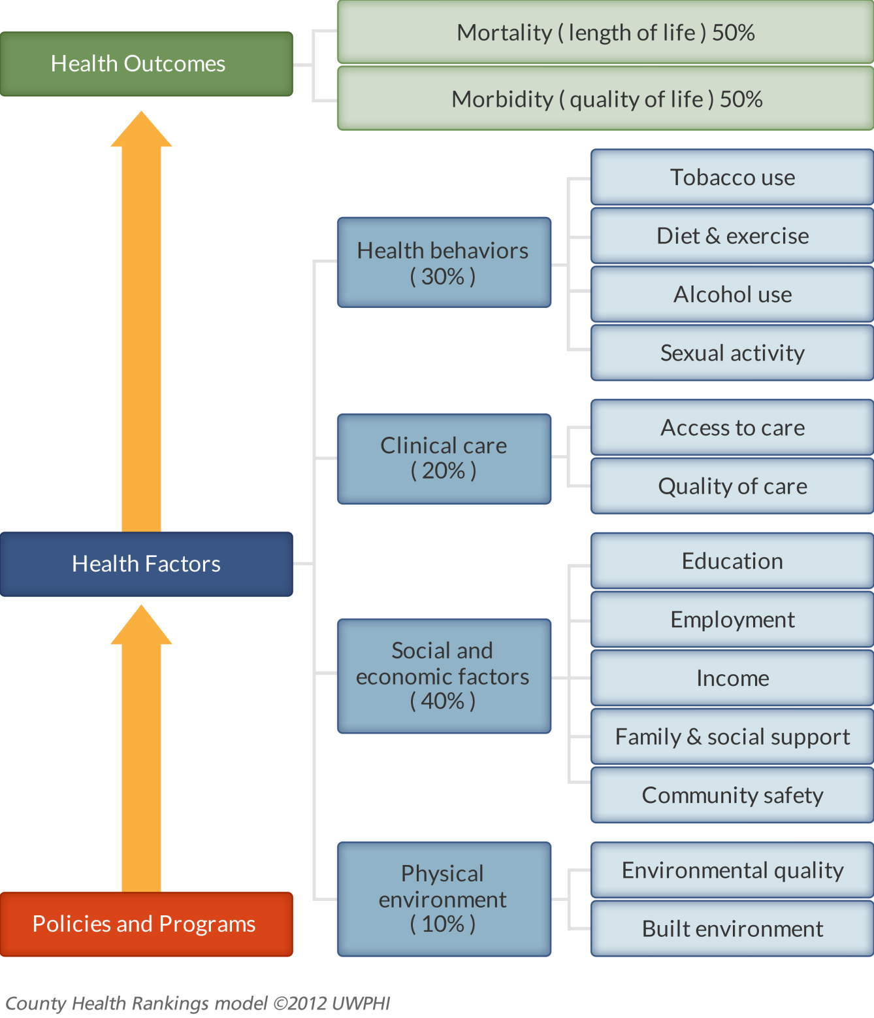
County Health Rankings Model

Slide 66
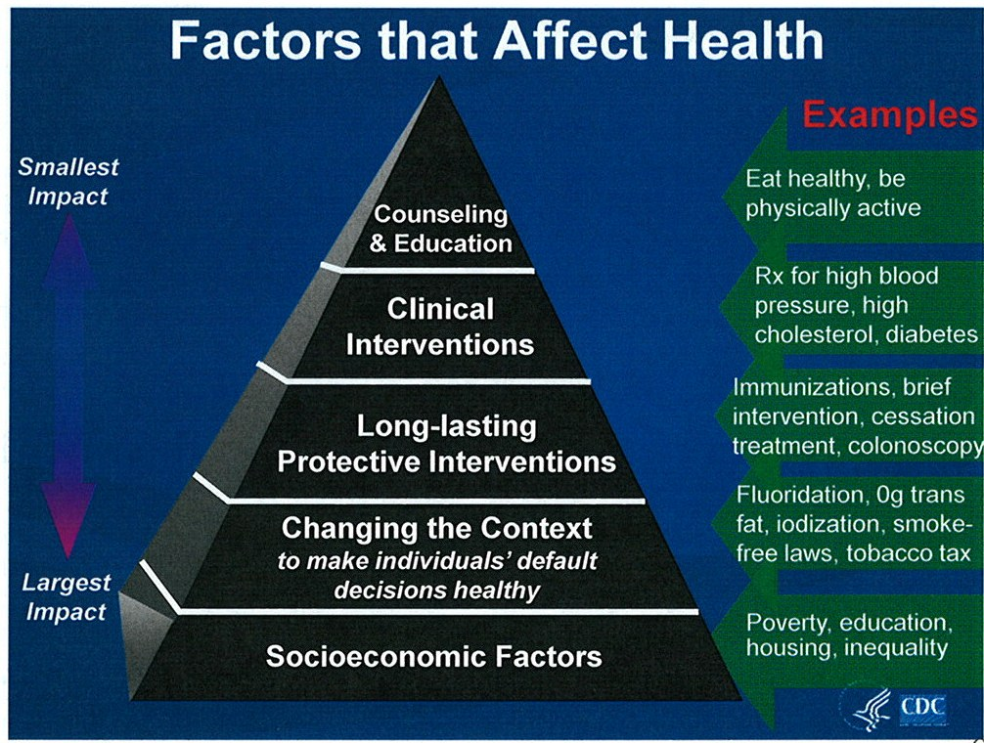

Slide 67
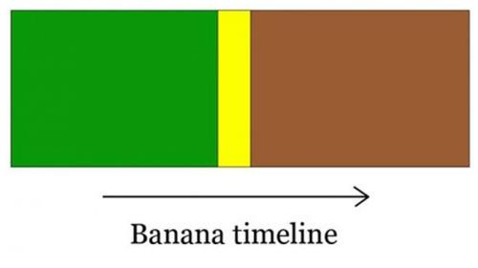
Table Activity PART THREE

Slide 68
d. What group is more likely to have the problem?
(DISPARITY- difference between groups)
This group has this rate, this other group has this rate.
Example: income predicts who smokes, rural predicts who smokes

Slide 69
e. So, why them?
Why are certain groups more likely to have the “problem”?
Example: Why do poor people smoke at higher rates that those in the middle class?
  Low-income young adults (who do not smoke at such high rates in high school), pick up smoking and become addicted while working in low-control service jobs that are high stress and only provide breaks for smokers.

Slide 70
f. Does the problem cause more bad things in some groups than others?
Example: low-income smokers are more likely to die of lung cancer than high-income smokers

Slide 71
g. Why here?
  How is the situation different in OUR community? Or is it?
  Example: People in Eaton County smoke at higher rates than those in other communities because there are more young adults who are not attending college that live here compared to other communities.

Slide 72
h. Why now?
What is the trend over time?
Example: the rates of smoking fell sharply in the 80’s and 90’s, but the decline has leveled off.

Slide 73
i. Programs, Resources, Policies
What helps or hurts the problem?
  Treatment: fixing or reversing the problem in individuals
  Early intervention: intervening early in problem behavior
  Laws and policies: Make the default decision a healthy decision
  Social Norms: Community culture supports healthy behavior
  Social Justice: Correct unfair disadvantage or unearned privilege

Slide 74
Sharing your data
Getting it out there!

Slide 75
What to Share
Why should you share your data?
  Inform
  Persuade

Slide 76
Translating Data
Scientific information
  Methodology
  Hypothesis/Results
  Uncertainty and limitations
Non-scientific information
  Anecdotes (stories)
  Advice from friends/relatives
  Personal experience

Slide 77
“Communicating data to non-scientists differs markedly from that of communicating with scientists; nonscientists want the bottom line about what the findings show, what they mean, and as a result, what should be done.”
- Nelson, in Communicating Public Health Information Effectively

Slide 78
Ethical Data Presentation
You are likely to be viewed as an expert
It is possible to skew your chart to show the result you want
It is possible to present information that is not statistically significant as if it were so
It is possible to cherry pick your indicators
Beware of over-generalization and
over-interpretation

Slide 79
Considerations for Deciding what data to Present…
Magnitude
  How big a problem is this?
Context
  Comparisons, trends
Meaning
  Is problem preventable? Who is at risk?
Action
  What needs to be done? What other info do we need?

Slide 80
Numerical Literacy
Humans mentally represent numbers in two major ways from observation (not formal math).^{[5]} These representations are innate; they are not the result of individual learning or cultural transmission.
They are
Approximate representations of numerical magnitude, and
Precise representations of distinct individuals.
SEE: Not Just a Number handout article.

Slide 81
Approximate representations of numerical magnitude
100 deaths from H1N1 / Swine Flu
600 deaths from Seasonal Influenza
100 deaths from H1N1 / Swine Flu
100 deaths from H1N1 / Swine Flu
100 deaths from H1N1 / Swine Flu
100 deaths from H1N1 / Swine Flu
100 deaths from H1N1 / Swine Flu
100 deaths from H1N1 / Swine Flu

Slide 82
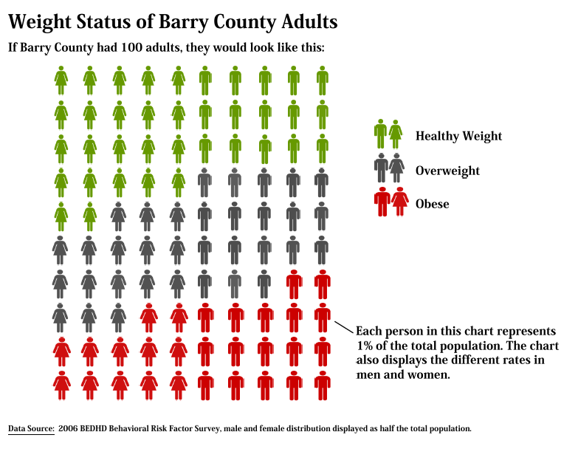
Precise Representation of Distinct Individuals

Slide 83
Create Numeric Analogies
“creative epidemiology” or “social math”
the number of deaths from cigarette smoking is equal to the number of deaths that would occur if 2 jumbo jets crashed every day with no survivors
1000 people quit smoking every day – by dying
90 classrooms of children begin smoking every day.

Slide 84
Other fun ones…
College students consume enough alcohol to fill 3,500 Olympic size swimming pools, or about 1 pool for every college campus
There are 10 times as many gun dealers in California as there are McDonald’s restaurants
Child health care workers make less than $10 per hour, whereas prison guards are paid more than $18 per hour
Every weekend, 16,000 teenagers will be infected with a sexually transmitted disease
Each year, 12 people die in the Barry-Eaton District simply from lack of health insurance

Slide 85
Things to consider…
Use numbers based on short time periods (hour or day rather than year or years)
Compare numbers to a specific place
Compare numbers to something familiar to the audience (number of McDonalds)
Use irony…carefully
Personalize numbers for the audience (6 out of 10 people in Charlotte will eventually die of cardiovascular disease)

Slide 86
Pitfalls
Presenting too much data
  No tables of data! Leads to overload…
Describing methodology
  Save this for the back of your BRFS report
Using statistical terms unnecessarily
  “Statistical terminology should be avoided.”
  No…statistically significant, confidence intervals, incidence, prevalence, regression analysis, etc.

Slide 87
Communicating with Policy Makers
Public Health Process (Rational Decision-Making) | Political Process (Intuitive Decision-Making)
Identify Problem | Identify Problem
Develop options | Place in context
Analyze options | Use judgment
Implement policy | Assess reaction
Evaluate effect | Prepare for next crisis

Slide 88
Forms of Visual Communication
Kind | Main Features | Major Uses
Table | Numbers in columns and rows | List specific numbers or text
Line Graph | Lines plotted on a grid over time | Examine trends
Bar Chart | Vertical or horizontal columns plotted on a grid | Highlight magnitude or comparison of numbers
Pie Chart | Divided circle that represents 100% | Display proportions totaling to 100%
Map | Geographic regions | Suggest geographic patterns or clusters
Picture | Actual or artistic representations | Demonstrate sequences, enhance key features, evoke emotions, provide realism
Typography | Text | Highlight words through layout design

Slide 89
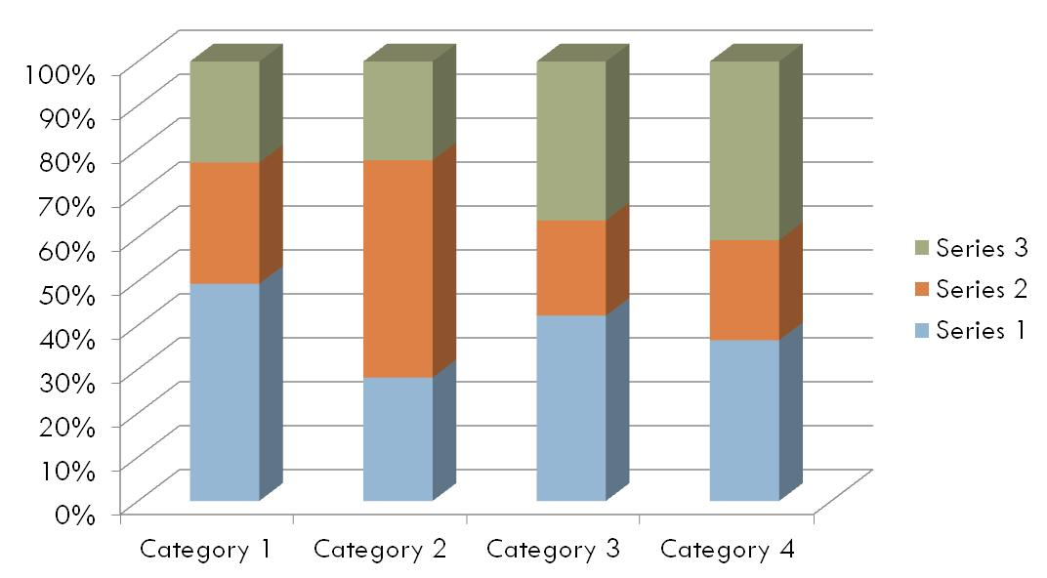
3-D Charts
Friends don’t let friends
make 3-D charts.

Slide 90
This is not good. Why?

Slide 91
Group PART FOUR
The purpose of this part of the day is to teach:
Ways to organize your data in Excel
How to construct a chart in Excel
How to get your chart from Excel into Publisher
How to develop a two-page handout in Publisher.

Slide 92
Debriefing
What part did you like best?
What part did you like least?
What was working with your group like?
What new skills did you learn?
What did you already know?
Is there anything you need more information or practice with before you feel you can do it yourself?

Slide 93
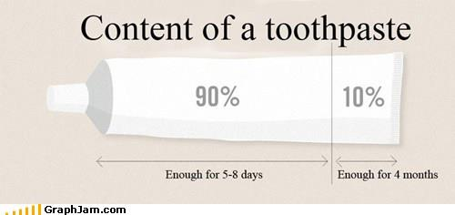
Lunchtime

Slide 94
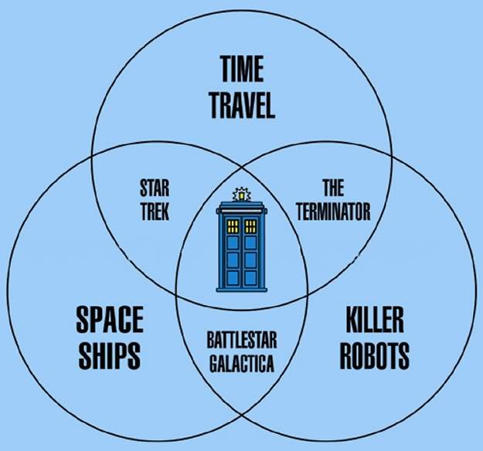
Break

